Slide 1
Agile: Lessons Learned (a retrospective)
Tony Dillon-Hansen
@iowatiger08
http://tigersndragons.com/

Slide 2
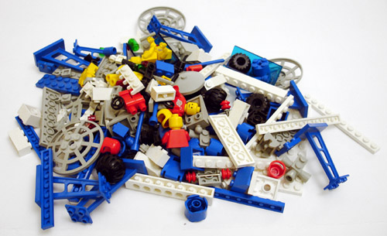
The Problem (a project)

Slide 3
Why do traditional approaches fail?
• THINGS CHANGE
• Things are hidden
• Requirements are not fully understood before the project begins. Teams and managers cannot envision all that will impact the project
• Users know what they want only after they see a POC.
• Requirements change often during the construction process.
• New tools and technologies make implementation strategies unpredictable.
• Priorities are impacted by orgs trying to accomplish everything in the triangle of work
Scope – schedule – cost compete for priority.

Slide 4
Agile :: Mindset shift
Rooted in Toyota production process
Quickly found favor among technology firms
Has its own manifesto
It’s a discipline!

Slide 5
The Agile “Solution”
Agile proposes – the core to solving project overruns is get everyone on the same page ASAP as often as possible
Open communication
Collaboration
Focus upon mutually agreed priority

Slide 6
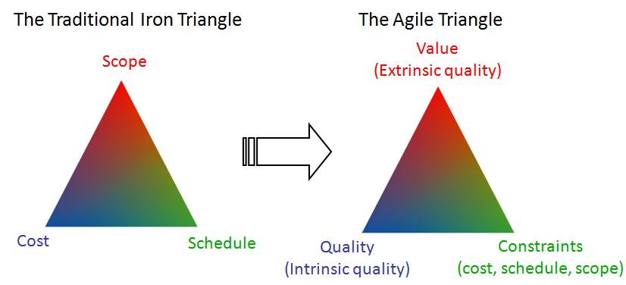
“2 out of 3 ain’t bad” but 3 out of 3 is not possible

Slide 7
Agile Terms
Agile: a methodology for planning work and delivering value that promotes collaboration, iterative development, and continuous improvement
Sprint: a time boxed work interval. Usually 1-4 weeks
Backlog: a list of all work that could be done, ordered by priority
Retrospective: Is a meeting that’s held at the end of a sprint. During the retrospective, the team reflect on what happened in the sprint and identifies actions for improvement going forward.

Slide 8
Agile is a process

Slide 10
Individuals and Interaction over process and tools
#1 reason why this is hard? It’s hard to communicate. Language is a problem, there are barriers, and there are differing skill levels of communication.
Organizations accustomed to silos-of-work and non-talking teammates will be most impacted by this (organizational shift)
Empower people to speak

Slide 11
Working software over comprehensive documentation

Slide 12
Customer collaboration over contract negotiations
Who is the customer of your project? The stakeholders?
They matter = They are the reason you are working
What is needed to make this effective for your customer?
Building trust and relationships to get things done
What do you really need to do? – Allows for evaluation of opportunity costs

Slide 13
Responding to change over a plan
That doesn’t mean agile projects reject planning. (Still need an overall plan, coaching and guidance)
There is a lot of planning that goes into agile projects.
15 minutes daily standup meetings
Bi-weekly sprint planning meetings
Bi-weekly retrospective meetings
Release planning
What happens if the customer changes or changes what they want?
Agile believes in adaptive planning and not a static plan.
Agile expects the plan is going to change and is able to respond to the change quicker without it having a big impact on the project.
All work is planned and prioritized in an agile project.
If you don’t know where you are going,
you’ll end up someplace else- Yogi Berra

Slide 14
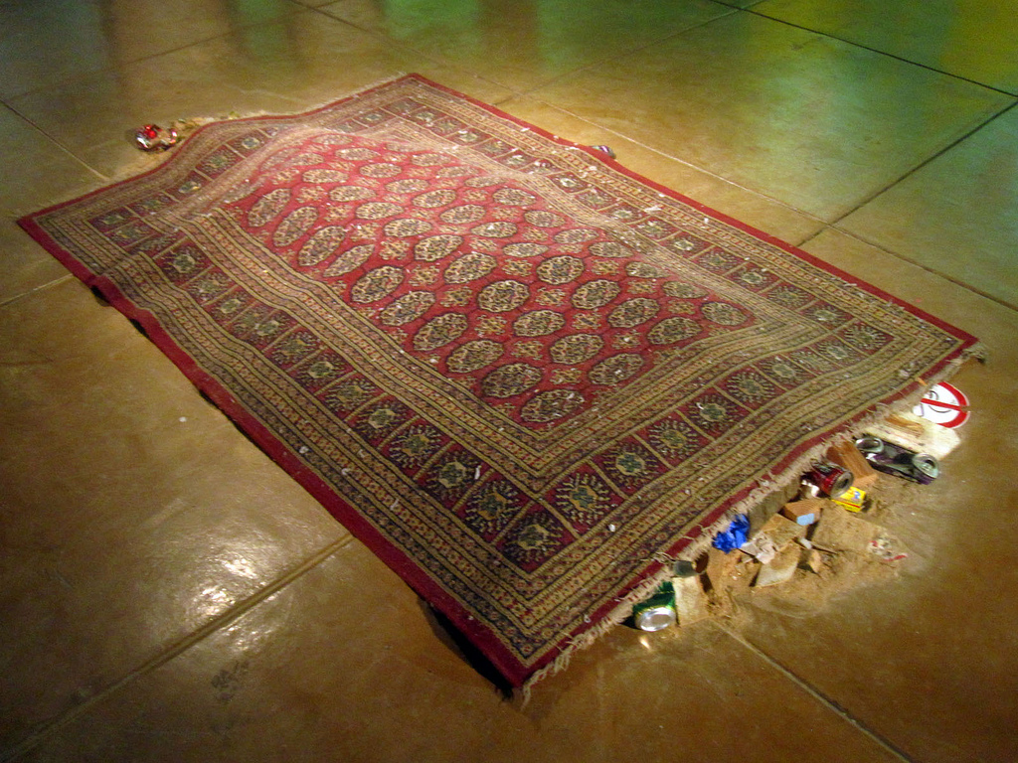
What does this mean for your team

Slide 15
What does this mean for your team
Teams will still need direction & guidance
Collective efforts will generate more productivity when everyone can see all that is being done as part of the team effort
You will see how much effort people pay into the goal
Learn effective grassroots organizing and planning

Slide 16
(conversely)
Agile is not meant to learn who avoids work.
What is the impediment? How can we handle the impediment as a team?
Individual subversion methods are poison & will ultimately hurt team performance and morale.

Slide 17
Think Different

Slide 18
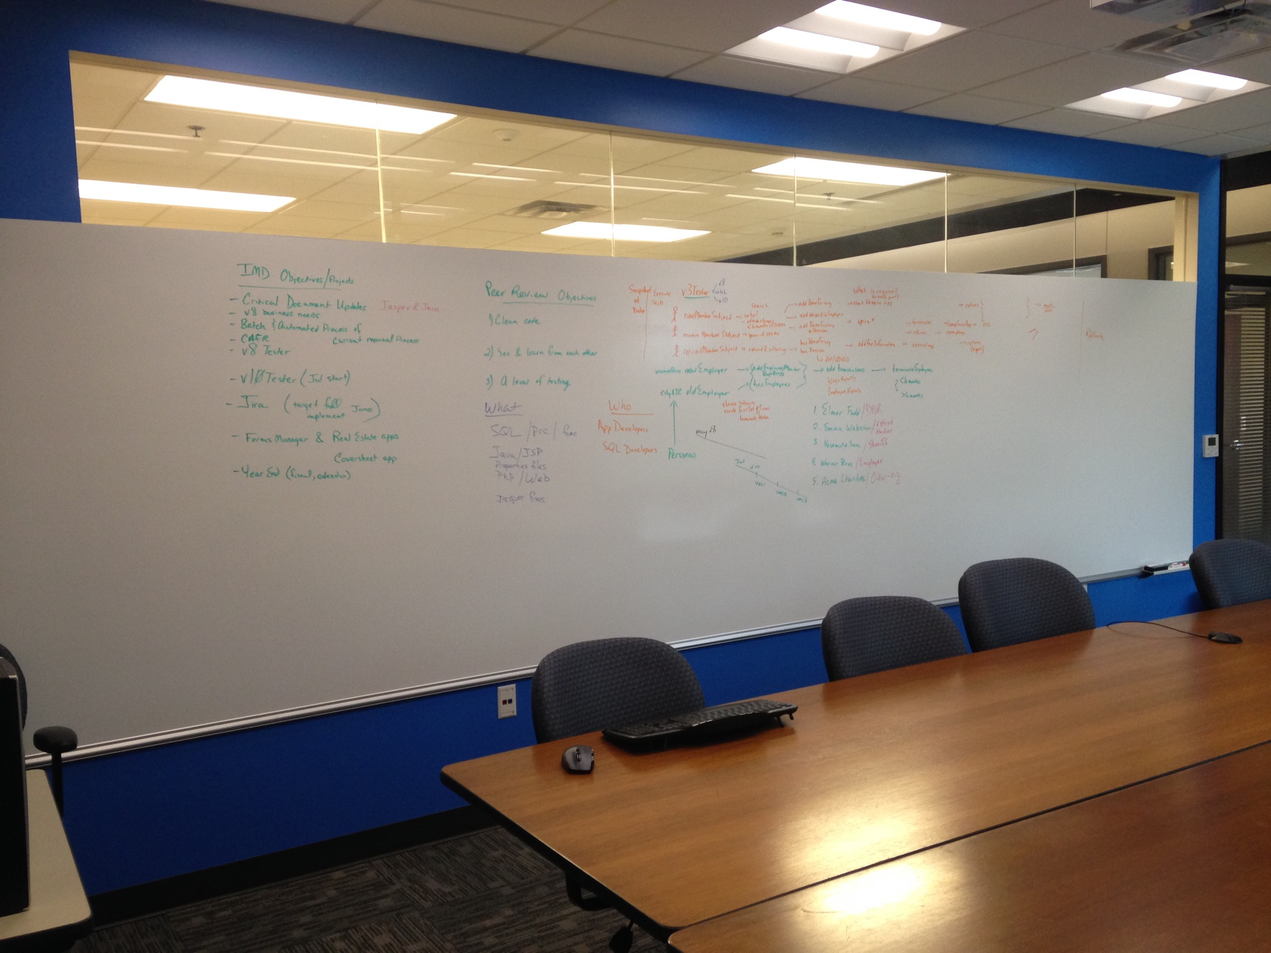

Slide 19
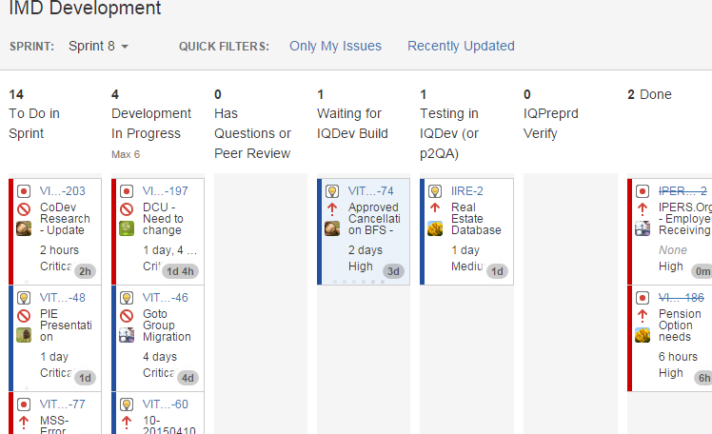
Tools can help

Slide 20
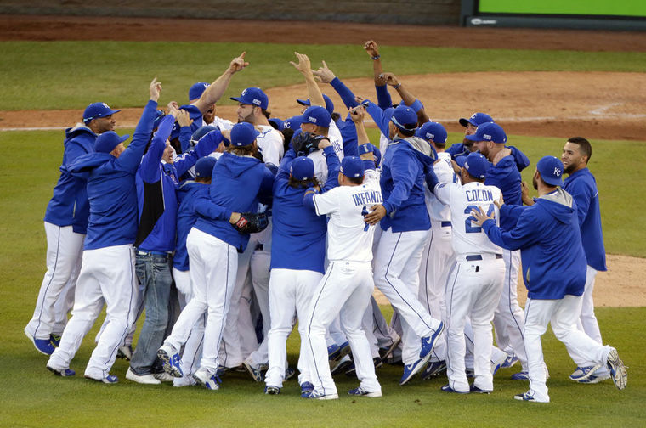
Agile is a Team effort/commitment

Slide 21
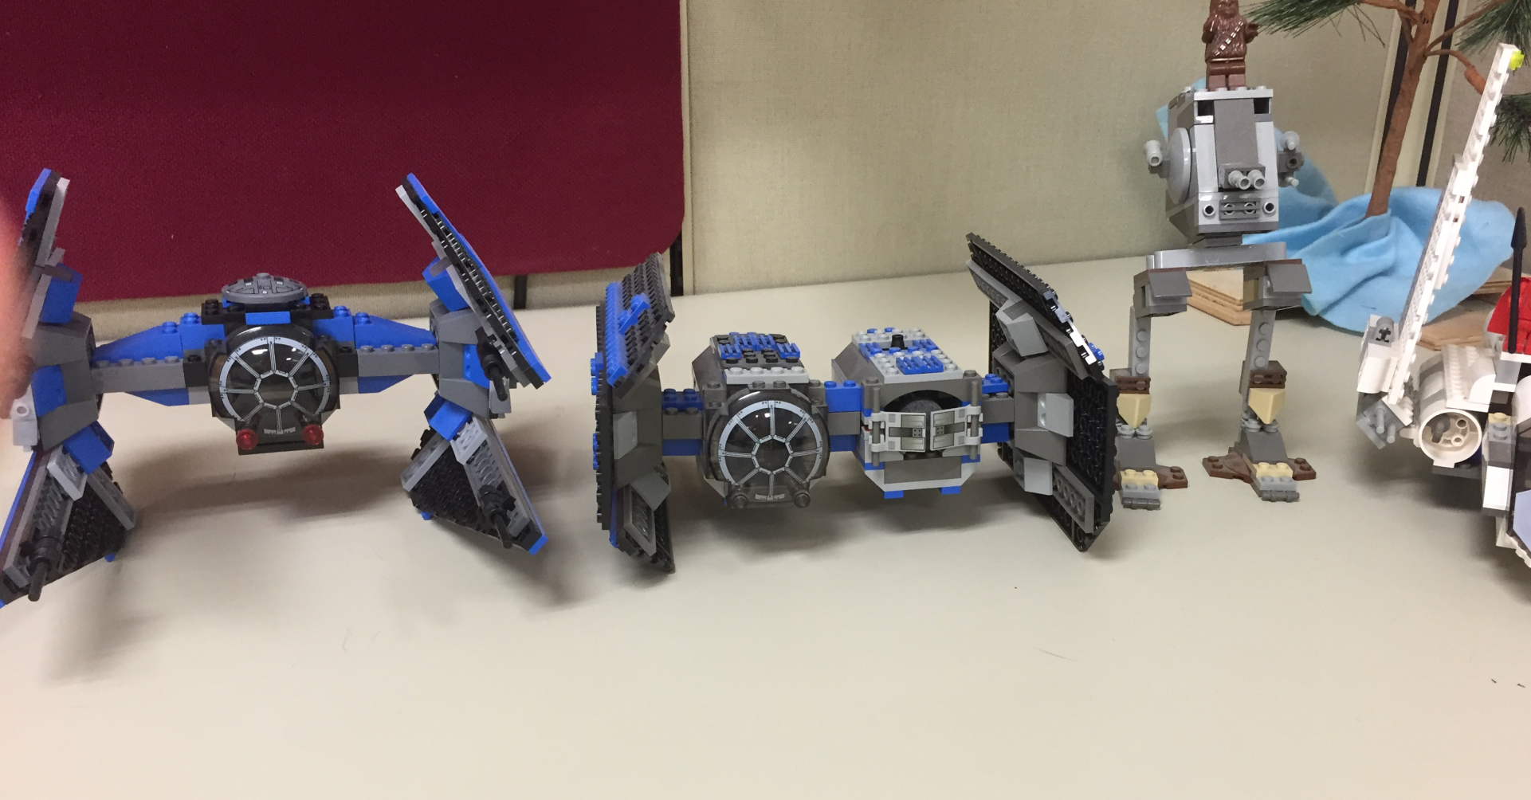
The Agile Solution (results)

